Slide 1


WIRELESS POWER TRANSFER FOR EV BATTERY CHARGING
The National Institute of Engineering
Department of Electrical and Electronics Engineering
Mananthavadi Road, Mysore-570008
Presented by
DARSHAN B K MITHUN URS P RAVI N SUNIL KUMAR S N
Under the Guidence of
MS.ASHWINI G BE,M.TECH

Slide 2
TABLE OF CONTENTS
CASE STUDY ON DYNAMIC CHARGING
BLOCK DIAGRAM
COMPONENTS
Li-ion BATTERY AND ITS SPECIFICATIONS
Cost estimation

Slide 3
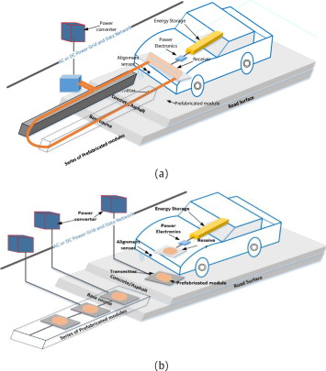
ABSTRACT
In order to improve the two areas of range and sufficient volume of battery storage, dynamic mode of operation of the WCS for EVs has been researched This method allows charging of battery storage devices while the vehicle is in motion.
The vehicle requires less volume of expensive battery storage and the range of transportation is increased
As shown in Fig. 11, the primary coils are embedded into the road concrete at a certain distance with high voltage, high frequency AC source and compensation circuits to the micro grid and/or RES.

Slide 4
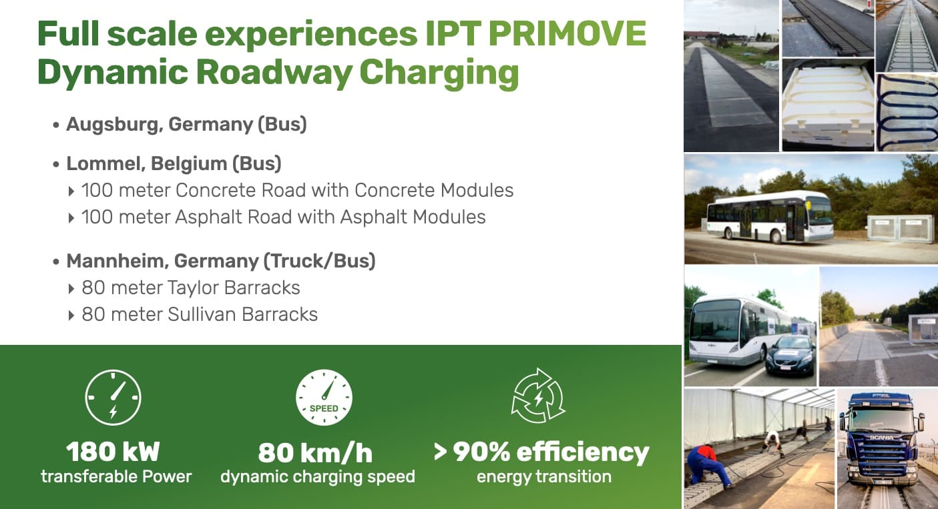

Slide 5
A Van Hool bus was adapted with a PRIMOVE energy pick-up system to demonstrate static and dynamic inductive charging on the road equipped with PRIMOVE technology.
The pick-up is powered by energy transfer segments of varying lengths installed in the 1.2 km road.

Slide 6

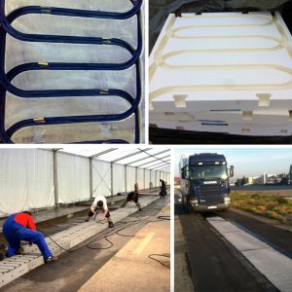
Demonstrating Dynamic charging for highway application
Vehicle: SCANIA Truck
Design constraints:
PRIMOVE 200 kW
System design based on PRIMOVE experiences
Pavement to be designed for public roads
Infrastructure according to existing design Taylor and Sullivan Barracks
The distance of the loop was calculated in order to be able to drive at 60 km/h on the PRIMOVE dynamic charging area. The whole length is approximately 330 meters. This should allow a heavy vehicle to roll at 60 km/h during 80 meters:
150 meters to achieve the speed of 80 km/h.
80 meters with Primove Dynamic charging
100 meters to break

Slide 7
INTRODUCTION
The wireless solution is increasingly spreading as method of battery charging for Electric Vehicles (EVs).
The standard technology of wireless EV battery charging is based on the Inductive Power Transfer (IPT) between two coupled coils, one connected to the electrical grid and the other one connected to the rechargable battery.
The IPT provides benefits in terms of safety and comfort, due to the absence of a plug-in operation
Through IPT, the electrocution risk typically arising from power cords is avoided and the battery charging operation can automatically start.
The wireless power transfer obviously represents the only solution for the dynamic charging, since the wired connection would be impossible during the motion.

Slide 8
LITERATURE SURvEY
Sl. No | Paper Name | Author | Year of Publication | Contents
1. | Inductive Wireless Power Transfer Charging for Electric Vehicles | AGANTI MAHESH , BHARATIRAJA, AND LUCIAN (Senior Member IEEE) | 2021 | Compensation at both sides needed to have exible and good working characteristics. Due to the network design, parasitic capacitance will not resonate enough or compensate the system. Therefore, additional reactive elements (capacitors or inductors), to adjust the operational resonant frequency.
2. | Analysis, Design and Realization of a WPT Charger for Electric Vehicles | Aziz Rachid, Hassan EL Fadil | 2022 | Calculation of the coil inductance begins with setting the desired quality factor. In practice, higher quality factors require high inductance values. This, in turn, leads to a coil with large dimensions.
3. | Wireless Power Transfer for Electric Vehicles: Foundations and Design Approach | Alicia Triviño-Cabrera, José M. González, José A. Aguado | 2020 | In order to improve the power transfer through the coupled coils, an increase in the operational frequency is required for WPT implementations. These conversions are carried out efficiently by power converters so that they can adjust the voltage levels, their frequency, the currents and/or the impedances with reduced losses. Power converters are composed of semiconductors configured to operate as switches varying their ideal state (open or closed) at a switching frequency.

Slide 9
PROBLEM STATEMENT
Wired charging system involves human intervention.
In wired charging power loss is high.
Wired charging involves Higher cost.

Slide 10
OBJECTIVE
Study and design the power circuitry for the WPTS. i.e., Rectifier circuit, Inverter circuit, Coupling coils and Compensation Networks.
The objective is to achieve Wireless power transfer via resonant inductive coupling between the transmitting and receiving coils in the near field.

Slide 11
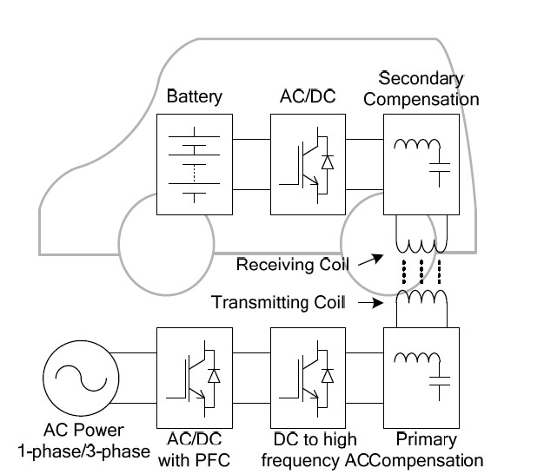
BLOCK DIAGRAM OF WPT MODEL

Slide 12
COMPONENTS
AC Voltage source.
Source rectifier circuit.
High frequency Inverter circuit.
Compensation network.
Mutual Inductor.
Vehicle Rectifier circuit.
Li-ion Battery.

Slide 13
THANK YOU

